Slide 1
Universal Response Engine: LLMs for Good
Team #35
Client: Ahmed Nazar
Advisor: Mohamed Selim

Slide 2
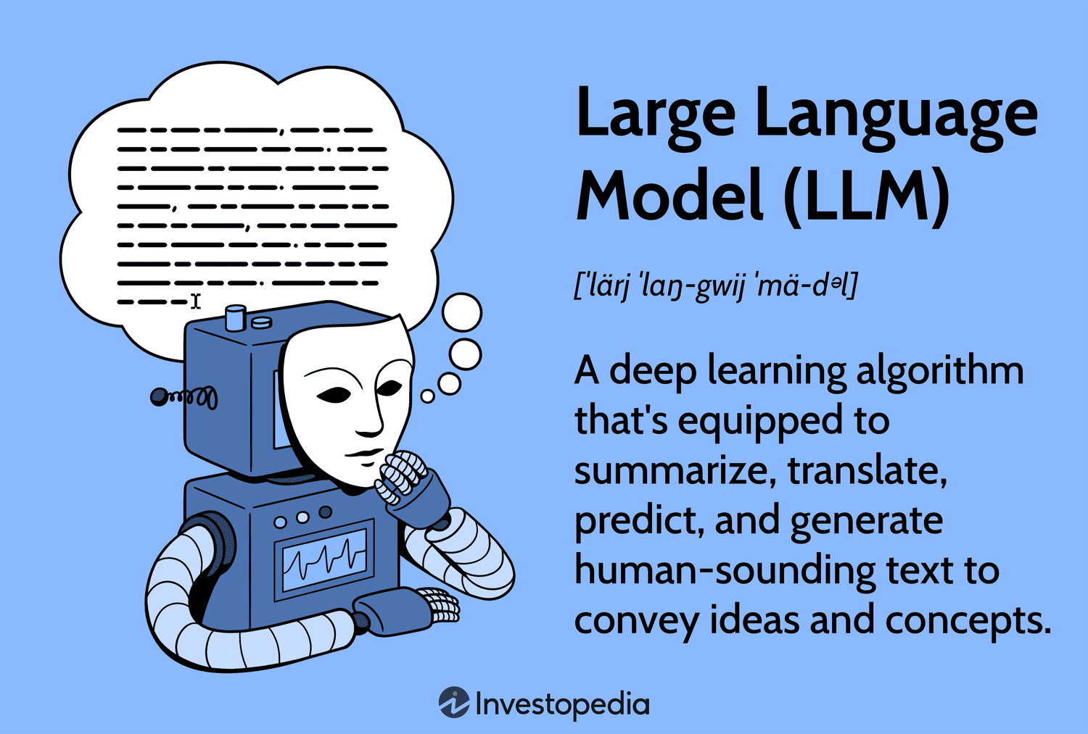
Notes:
What is an LLM?
Go back a few steps…
AI: broad term, intelligent machines
ML: subfield of AI, pattern recognition, predicting data
LLMs: subfield of ML, taking pattern recognition and a combination of other ideas to start generating text, like natural languages, and other data
How do LLMs work?
Combine lots of datasets
Feed data to a neural network that processes it with calculations (like calculating similarity between words)
Finetune it by training it on specific datasets

Slide 3
Project Overview
Creating an LLM for humanitarian use
Chatbot-like website where users provide questions/prompts
Model responds with relevant links, media, info (multimodal)
Notes:
Our project aims to address a critical gap in accessible and comprehensible support for individuals facing challenges. Many people experience difficult circumstances and may feel isolated when seeking help. Although there are a lot of good resources available, they are often fragmented and require these distraught people to sift through multiple pages of information from different sources.
What makes it different: societal good, open-source, no data tracking, to help people in vulnerable situations
Fine-tuned, trained, vetted on empathetic datasets that provide medical advice, emergency advice, etc.

Slide 4
Professional Responsibility - Good Performance
Communication Honesty
This is relevant to our project because we are providing a product that was proposed by our advisor, oh whom we must communicate details about scope and deadlines with.
Our team’s approach to this communication is by having weekly meetings with our advisor to give progress updates, learning sessions, and discuss future goals.
This upholds our ethical and professional responsibilities because we are truthfully reporting our work to our stakeholder, which is our advisor.

Slide 5
Professional Responsibility - Subpar Performance
Health, Safety, & Well-being
This is relevant to our project because we want our product to do good to the public and our stakeholder.
Our team’s approach to this is to be empathetic to our stakeholder and prospective users by hopefully implementing sentiment analysis in our model and to listen to our advisor/stakeholder concerns.
We will change our approach by taking our advisor’s worries more seriously and keeping close tabs on progress he desires

Slide 6
Four Principles Chart
 | Beneficence | Nonmaleficence | Respect for Autonomy | Justice
Social Equity | Ensure equal access to resources for all | Avoid increasing existing inequalities | Empowers all users to make their own decisions and access resources freely | Ensure fair distribution of benefit
Privacy and Security | Ensure data protection to benefit users | Prevent data breaches or unauthorized access | Helps user control their own personal data | Safeguard privacy for all the users
Environmental & Economical | Usage of cloud-based system; no physical materials needed | We are trying to make an efficient model that doesn’t use an excess amount of energy | We will have no paywalls or restrictions that require users’ money | We want to prioritize an energy efficient and equitable large language model
Ethical AI (important) | Our model should benefit others in a positive way by generating knowledgeable, truthful, and empathetic responses | Our project aims to assist people in need and avoid any harm to others | Our product will be usable by users who have any type of device that has internet and a browser | The model will be fair and unbiased toward users
Notes:
Share your Broader Context Area-Four Principles chart
Highlight one area that is important to your project

Slide 7
Ethical Issues
A potential ethical issue we are concerned about is our model providing biased and untruthful information.
If our model gives a user incorrect information, that is ethically irresponsible and puts the user, who is our top priority, at risk.

Slide 8
Virtue
Empathy: This is important because it makes us understand the diverse needs of the user, especially in tough situations. It ensure that the project is designed with care and consideration for the user’s experience, ensuring the application empathetic for those in need. By empathizing with the users, we can create solutions that are effective.

